Slide 1
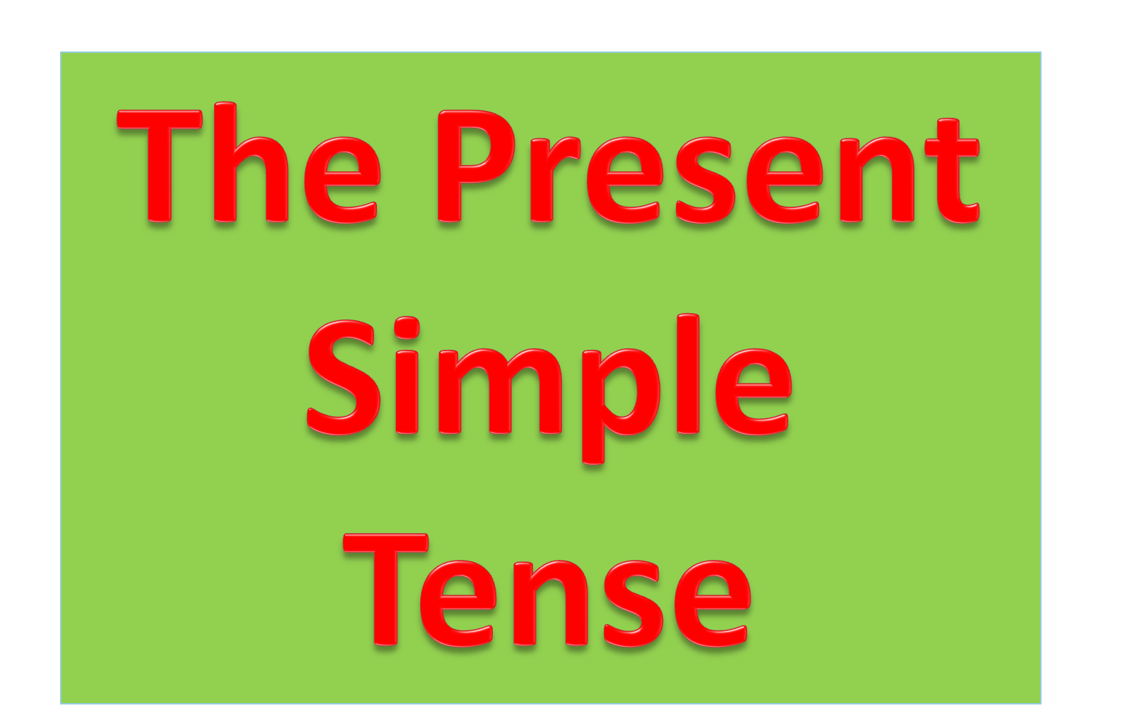

Slide 2
Positive and Negative
I We You They | like cheese. don’t like cheese.
He She It | likes cheese. doesn’t like cheese.

Slide 3
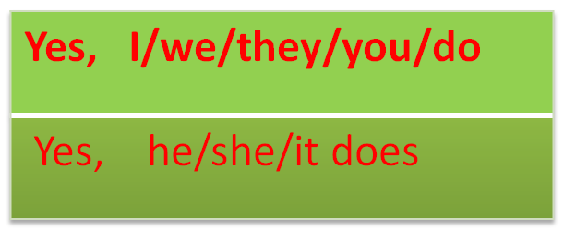
Questions and Short Answers
I you we they he she it | like cheese?
Do
Does
No, I/we/you/they don’t
No he/she/it doesn’t.

Slide 4
Present Simple Usage

Slide 5
Habits
We use the Present Simple to talk about things we do all of the time.
Examples:
I get the service bus at 7:00 every morning.
Ali brushes his teeth before he goes to bed.
I play football at break time.
My sister goes sailing at the weekend.

Slide 6
Things that are always true
We use the Present Simple to talk about things that are always true.
The sky is blue.
The Earth goes round the Sun.
I am a student.
SEV is on the Asian Side of Istanbul.
Tigers are big cats.
School starts at 8.05am and finishes at 3.30pm.

Slide 7

Verbs ending in ch, s, sh, o, x
add – es
watch – watches
guess – guesses
finish – finishes
go – goes
fix - fixes
Verbs ending in a consonant (b,c,d,f,g...)
change y to ies
study – studies
carry – carries
Fly - flies

Slide 8

Do he like basketball?
I likes eating pizza.
She do her homework on the service bus.
The film finishs at eight.
My friends goes on holiday next week.
She carrys her little sister to the car in the morning.
Nicole Kidman act in a lot of films.
We plays in the garden at break.
Our teacher talk very clearly.

